Slide 1
California Interscholastic Federation
SCVOA
Southern California Volleyball Officials Association
Scorer Training
2016/2017

Slide 2
Today’s Match
Varsity match held on August 13, 2016
At West High School
Visiting is East High School
Game time is 3:00 PM
R1 is Mary Jane
R2 is John Smith
Scorekeeper is…(YOU)

Slide 3
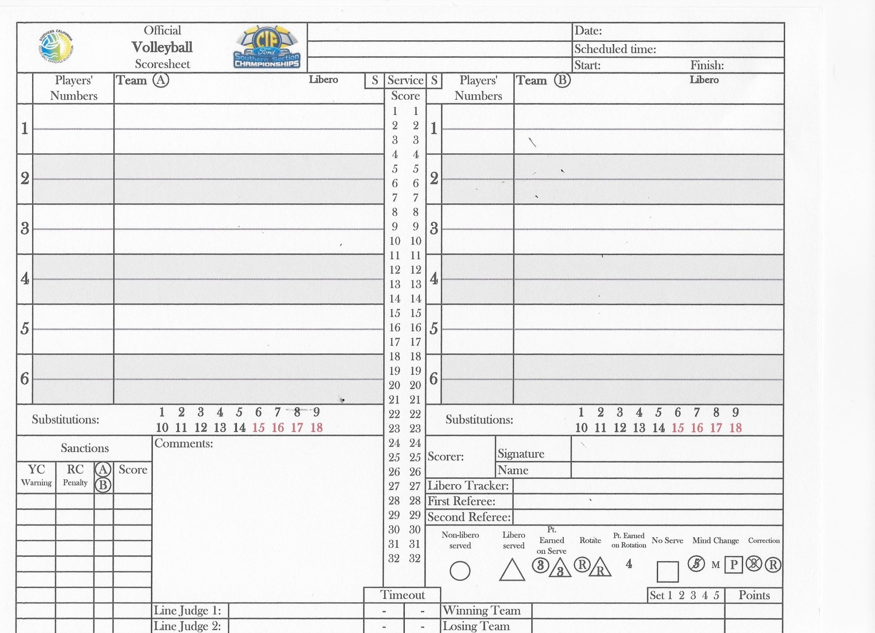
West vs. East
August 13, 2016
West High School
3:00 PM
Varsity

Slide 4
West High School
August 13, 2016
West vs. East
3:00 PM
Varsity
“Your Name”
“Their Name”
Mary Jane
John Smith

Slide 5
West vs. East
August 13, 2016
West High School
3:00 PM
Varsity
East
West
The four (4) sets for Varsity and
two (2) set for Non-Varsity matches,
the team on the “A” side will
serve first. Teams will alternate sides
with each set. A coin toss for the
deciding set will determine which
side will serve first.
At 2:40 the R1 raises her coin and
tweets her whistle twice. West has
selected the bench to the right “B”.
After R1s instructions she flips her
coin and East captain calls “heads”;
it is heads. The captain selects to serve.
Scorer will circle the “S” at the top
of the score column to indicate
East has first Serve.
“Your Name”
“Their Name”
Circle the first (1) set.
Mary Jane
John Smith

Slide 6
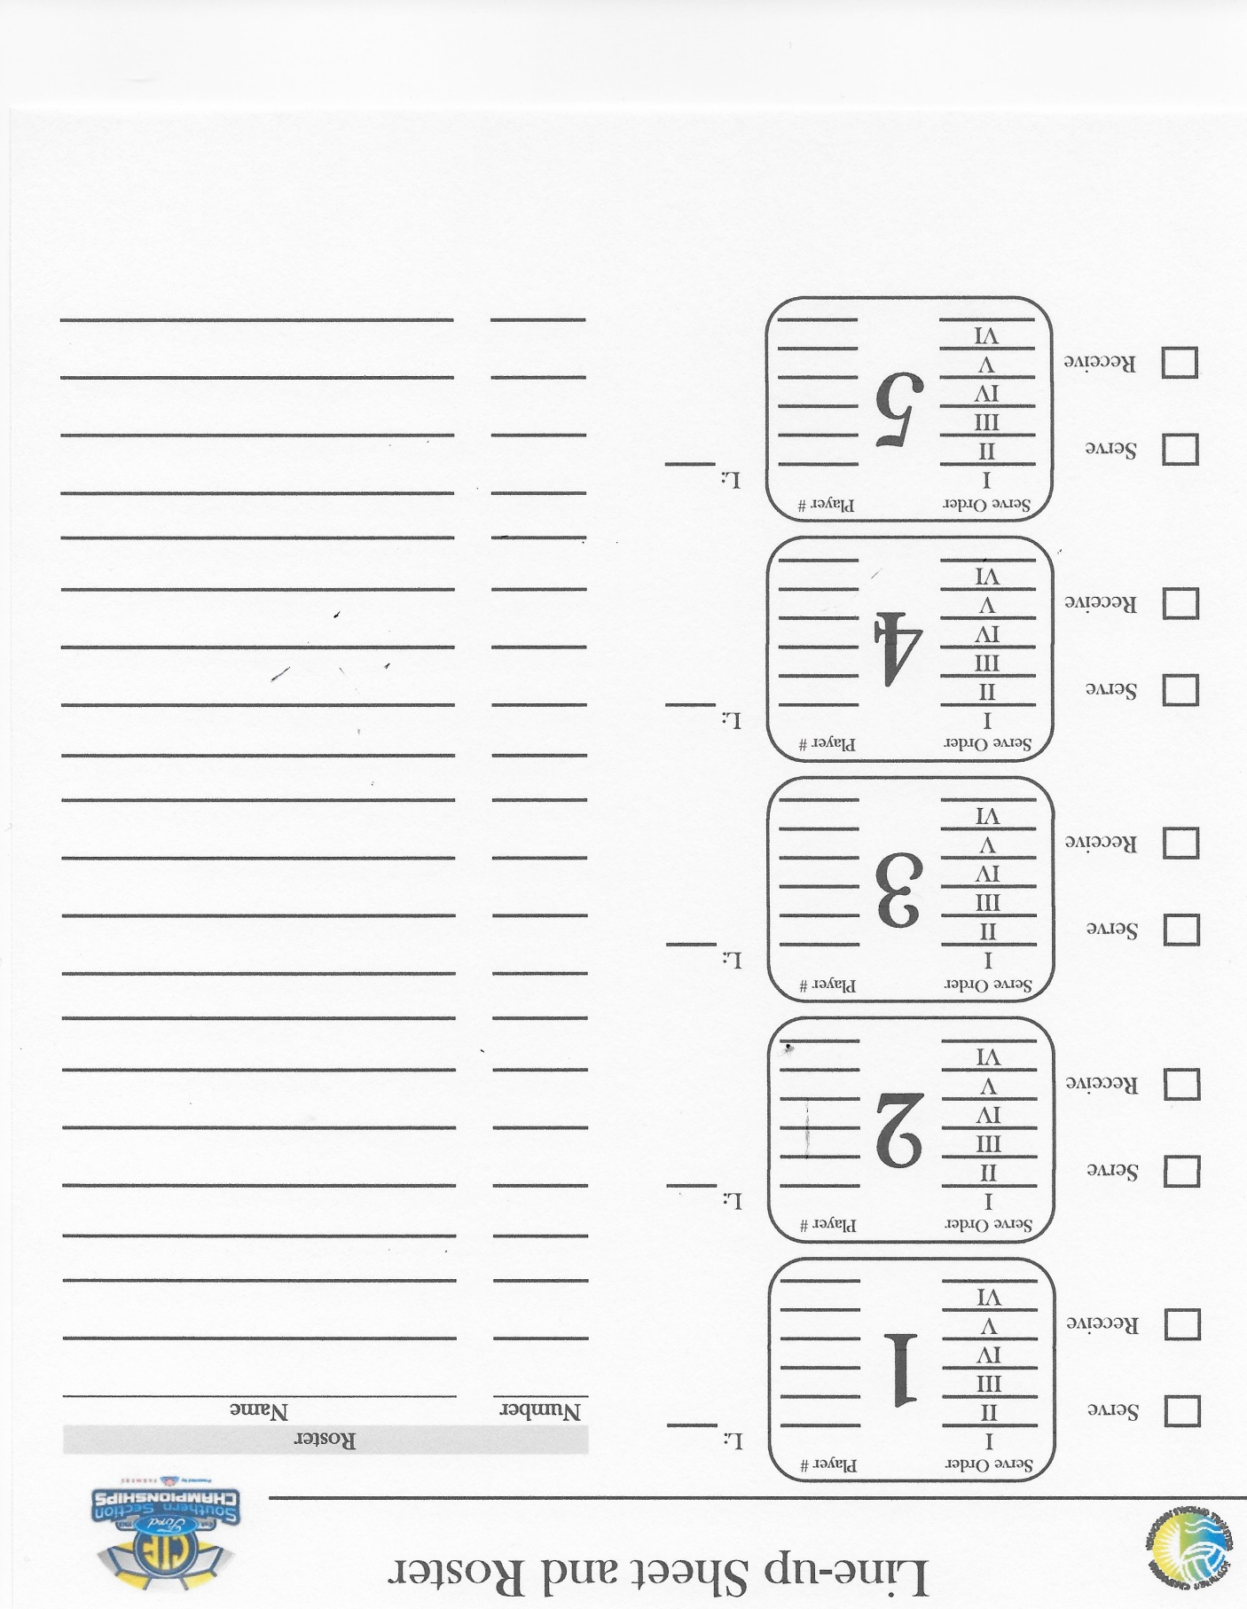
3
5
7c
13
1 Autumn Binder
21
15
3 Betty Crosby
11
5 Christina Devour
7 Debbie Edger
Ten (10) minutes before the end
of the timed warmup (2:50 PM)
each team coach will turn in a
roster with the names and numbers
of each player on the team.
Two (2) minutes before the end
of the timed warmup (2:58 PM)
each team coach will turn in a
Lineup of the starting players for
the first set. A small “c” will designate
the playing captain for the first set.
9 Ellen Flynn
11 Florence Goodwin
13 Grace Hogarth
15 Hana Isenberg
17 Iris Johnson
19 Jane Kingston
21 Kelli Larson
23 Laurie Morrison

Slide 7
West vs. East
August 13, 2016
West High School
3:00 PM
Varsity
East
5
West
24
3
4
7c
First server for East
will be in the #1 position
on the court, right back.
10
First server for West
will be in the #2 position
on the court, right front.
13
6
21
8
15
12c
11
14
When the scorer receive the lineups, they
will check to see that a captain and Libero
are designated. If not the R2 will check with
the coach to see who the captain is and if
they will be using a Libero.
“Your Name”
“Their Name”
Mary Jane
John Smith

Slide 8
3
7c
13
21
15
11
East
Lineup
West
Lineup
4
10
6
8
12c
14
4
14
10
15
21
13
12
7
11
8
3
6

Slide 9
West vs. East
August 13, 2016
West High School
3:00 PM
Varsity
3:02 PM
East
5
West
24
3
4
7c
10
At the contact of the ball for the first
service, enter the start time of 3:02 PM.
Then draw circle on the line in #3
individual area.
13
6
21
8
15
12c
11
14
“Your Name”
“Their Name”
Mary Jane
John Smith

Slide 10
West vs. East
August 13, 2016
West High School
3:00 PM
Varsity
3:02 PM
East
5
West
24
3
1
2
3
R
4
7c
10
13
6
E3 serves for three points 1, 2, 3.
Next serve is a loss of rally
21
8
15
12c
11
14
“Your Name”
“Their Name”
Mary Jane
John Smith

Slide 11
West vs. East
August 13, 2016
West High School
3:00 PM
Varsity
3:02 PM
East
5
West
24
3
1
2
3
R
4
1
R
7c
10
13
6
West loss of rally point 1
West 4 serves loss rally.
21
8
15
12c
11
14
“Your Name”
“Their Name”
Mary Jane
John Smith

Slide 12
West vs. East
August 13, 2016
West High School
3:00 PM
Varsity
3:02 PM
East
5
West
24
3
1
2
3
R
4
1
R
7c
4
5
6
10
13
6
Loss of rally point 4.
East 7 serves two straight points 5, 6.
21
8
15
12c
11
14
“Your Name”
“Their Name”
Mary Jane
John Smith

Slide 13
West vs. East
August 13, 2016
West High School
3:00 PM
Varsity
3:02 PM
East
5
West
24
3
1
2
3
R
4
2
1
R
7c
4
5
6
Sx 2/4
10
13
6
West calls for a substitution: 2 for 4.
21
8
15
12c
11
14
“Your Name”
“Their Name”
Mary Jane
John Smith

Slide 14
West vs. East
August 13, 2016
West High School
3:00 PM
Varsity
3:02 PM
East
5
West
24
3
1
2
3
R
4
2
1
R
7c
4
5
6
Sx 2/4
7
8
10
13
6
E7 serves two more points: 7, 8.
E13 receives a red card for
unsportsman like conduct.
Loss of rally
21
8
15
12c
11
14
“Your Name”
“Their Name”
13
A
8-1
Mary Jane
John Smith

Slide 15
West vs. East
August 13, 2016
West High School
3:00 PM
Varsity
3:02 PM
East
5
West
24
3
1
2
3
R
4
2
1
R
7c
4
5
6
Sx 2/4
7
8
R
10
2
13
6
21
Loss of rally point 2.
8
15
12c
11
14
“Your Name”
“Their Name”
13
A
8-1
Mary Jane
John Smith

Slide 16
West vs. East
August 13, 2016
West High School
3:00 PM
Varsity
3:02 PM
East
5
West
24
3
1
2
3
R
4
2
1
R
7c
4
5
6
Sx 2/4
7
8
R
10
2
3
4
5
Tx
13
6
21
W10 serves three points
3, 4, 5.
East call time out.
8
15
12c
11
14
“Your Name”
“Their Name”
13
A
8-1
Mary Jane
John Smith
8
5

Slide 17
West vs. East
August 13, 2016
West High School
3:00 PM
Varsity
3:02 PM
East
5
West
24
3
1
2
3
R
4
2
1
R
7c
4
5
6
Sx 2/4
7
8
R
10
2
3
4
5
Tx
Sx 1/13
13
1
6
21
At the end of time out
East substitutes 1 for 13
8
15
12c
11
14
“Your Name”
“Their Name”
13
A
8-1
Mary Jane
John Smith
8
5

Slide 18
West vs. East
August 13, 2016
West High School
3:00 PM
Varsity
3:02 PM
East
5
West
24
3
1
2
3
R
4
2
1
R
7c
4
5
6
Sx 2/4
7
8
R
10
2
3
4
5
Tx
Sx 1/13
6
7
8
13
1
6
21
W10 serves three
more points 6, 7, 8
8
15
12c
11
14
“Your Name”
“Their Name”
13
A
8-1
Mary Jane
John Smith
8
5

Slide 19
West vs. East
August 13, 2016
West High School
3:00 PM
Varsity
3:02 PM
East
5
West
24
3
1
2
3
R
4
2
1
R
7c
4
5
6
Sx 2/4
7
8
R
10
2
3
4
5
Tx
Sx 1/13
6
7
8
R
13
1
6
21
East 21 is given a yellow card for
misconduct.
West 10 next serve is loss of rally.
8
15
12c
11
14
“Your Name”
“Their Name”
13
A
8-1
Mary Jane
21
A
8-8
John Smith
8
5

Slide 20
West vs. East
August 13, 2016
West High School
3:00 PM
Varsity
3:02 PM
East
5
West
24
3
1
2
3
R
4
2
1
R
7c
4
5
6
Sx 2/4
7
8
R
10
2
3
4
5
Tx
Sx 1/13
6
7
8
R
13
1
9
R
6
21
8
Lose of rally point 9.
East 1 serves…
and a loss of rally.
15
12c
11
14
“Your Name”
“Their Name”
13
A
8-1
Mary Jane
21
A
8-8
John Smith
8
5

Slide 21
West vs. East
August 13, 2016
West High School
3:00 PM
Varsity
3:02 PM
East
5
West
24
3
1
2
3
R
4
2
1
R
7c
4
5
6
Sx 2/4
7
8
R
10
2
3
4
5
Tx
Sx 1/13
6
7
8
R
13
1
9
R
6
9
21
8
Lose of rally point 9.
15
12c
11
14
“Your Name”
“Their Name”
13
A
8-1
Mary Jane
21
A
8-8
John Smith
8
5

Slide 22
West vs. East
August 13, 2016
West High School
3:00 PM
Varsity
3:02 PM
East
5
West
24
3
1
2
3
R
4
2
1
R
7c
4
5
6
Sx 2/4
7
8
R
10
2
3
4
5
Tx
Sx 1/13
6
7
8
R
13
1
9
R
6
9
10
11
21
8
15
12c
Libero replacement for
West 6 and serves…
two points 10, 11.
11
14
“Your Name”
“Their Name”
13
A
8-1
Mary Jane
21
A
8-8
John Smith
8
5

Slide 23
West vs. East
August 13, 2016
West High School
3:00 PM
Varsity
3:02 PM
East
5
West
24
3
1
2
3
R
4
2
1
R
7c
4
5
6
Sx 2/4
7
8
R
10
2
3
4
5
Tx
Sx 1/13
6
7
8
R
13
1
9
R
6
9
10
11
12
21
8
15
12c
Next serve begins with a re-serve;
then a penalty point is
awarded West for Red
card on East 21.
11
14
“Your Name”
“Their Name”
13
A
8-1
Mary Jane
21
A
8-8
John Smith
21
A
9-11
8
5

Slide 24
West vs. East
August 13, 2016
West High School
3:00 PM
Varsity
3:02 PM
East
5
West
24
3
1
2
3
R
4
2
1
R
7c
4
5
6
Sx 2/4
7
8
R
10
2
3
4
5
Tx
Sx 1/13
6
7
8
R
13
1
9
R
6
9
10
11
12
Tx
21
8
East calls for a time out.
15
12c
11
14
“Your Name”
“Their Name”
13
A
8-1
Mary Jane
21
A
8-8
John Smith
21
A
9-11
8
5
9
12

Slide 25
West vs. East
August 13, 2016
West High School
3:00 PM
Varsity
3:02 PM
East
5
West
24
3
1
2
3
R
4
2
1
R
7c
4
5
6
Sx 2/4
7
8
R
10
2
3
4
5
Tx
Sx 1/13
6
7
8
R
13
1
9
R
6
9
10
11
12
Tx
13
R
21
8
15
12c
11
14
West Libero serves for
Point 13…
Next serve is loss of rally
“Your Name”
“Their Name”
13
A
8-1
Mary Jane
21
A
8-8
John Smith
21
A
9-11
8
5
9
12

Slide 26
West vs. East
August 13, 2016
West High School
3:00 PM
Varsity
3:02 PM
East
5
West
24
3
1
2
3
R
4
2
1
R
7c
4
5
6
Sx 2/4
7
8
R
10
2
3
4
5
Tx
Sx 1/13
6
7
8
R
13
1
9
R
6
9
10
11
12
Tx
13
R
21
10
8
15
12c
Loss of rally point 10
11
14
“Your Name”
“Their Name”
13
A
8-1
Mary Jane
21
A
8-8
John Smith
21
A
9-11
8
5
9
12

Slide 27
West vs. East
August 13, 2016
West High School
3:00 PM
Varsity
3:02 PM
East
5
West
24
3
1
2
3
R
4
2
1
R
7c
4
5
6
Sx 2/4
7
8
R
10
2
3
4
5
Tx
Sx 1/13
6
7
8
R
13
1
9
R
6
9
10
11
12
Tx
13
R
21
10
11
12
13
R
8
15
12c
East Libero replaces 21 and
Serves three points 11, 12, 13
Next serve is a loss of rally
11
14
“Your Name”
“Their Name”
13
A
8-1
Mary Jane
21
A
8-8
John Smith
21
A
9-11
8
5
9
12

Slide 28
West vs. East
August 13, 2016
West High School
3:00 PM
Varsity
3:02 PM
East
5
West
24
3
1
2
3
R
4
2
1
R
7c
4
5
6
Sx 2/4
7
8
R
10
2
3
4
5
Tx
Sx 1/13
6
7
8
R
13
1
9
R
6
9
10
11
12
Tx
13
R
21
10
11
12
13
R
8
14
R
15
12c
Loss of rally point 14
West 8 serves
for loss of rally
11
14
“Your Name”
“Their Name”
13
A
8-1
Mary Jane
21
A
8-8
John Smith
21
A
9-11
8
5
9
12

Slide 29
West vs. East
August 13, 2016
West High School
3:00 PM
Varsity
3:02 PM
East
5
West
24
3
1
2
3
R
4
2
1
R
7c
4
5
6
Sx 2/4
7
8
R
10
2
3
4
5
Tx
Sx 1/13
6
7
8
R
13
1
13
9
R
6
9
10
11
12
Tx
13
R
21
10
11
12
13
R
8
14
R
15
14
S 13/1
12c
11
14
Loss of rally point 14
East substitutes 13 for 1
“Your Name”
“Their Name”
13
A
8-1
Mary Jane
21
A
8-8
John Smith
21
A
9-11
8
5
9
12

Slide 30
West vs. East
August 13, 2016
West High School
3:00 PM
Varsity
3:02 PM
East
5
West
24
3
1
2
3
R
4
2
1
R
7c
4
5
6
Sx 2/4
7
8
R
10
2
3
4
5
Tx
Sx 1/13
6
7
8
R
13
1
13
9
R
6
9
10
11
12
Tx
13
R
21
10
11
12
13
R
8
14
R
15
14
S 13/1
15
12c
11
14
East 15 serves
point 15
“Your Name”
13
A
8-1
“Their Name”
21
A
8-8
Mary Jane
A
John Smith
21
9-11
8
5
9
12

Slide 31
West vs. East
August 13, 2016
West High School
3:00 PM
Varsity
3:02 PM
East
5
West
24
3
1
2
3
R
4
2
1
R
7c
4
5
6
Sx 2/4
7
8
R
10
2
3
4
5
Tx
Sx 1/13
6
c
7
8
R
13
1
13
9
R
6
9
10
11
12
Tx
13
R
21
10
11
12
13
R
8
14
R
15
14
S 13/1
15
Sx 20/12
12c
20
11
14
“Your Name”
West coach call for substitution of 20 for 12
Remind R2 West needs a Captain, it is 10
“Their Name”
13
A
8-1
Mary Jane
21
A
8-8
John Smith
21
A
9-11
8
5
9
12

Slide 32
West vs. East
August 13, 2016
West High School
3:00 PM
Varsity
3:02 PM
East
5
West
24
3
1
2
3
R
4
2
1
R
7c
4
5
6
Sx 2/4
7
8
R
10
2
3
4
5
Tx
Sx 1/13
6
c
7
8
R
13
1
13
9
R
6
9
10
11
12
Tx
13
R
21
10
11
12
13
R
8
14
R
15
14
S 13/1
15
Sx 20/12
R
12c
20
11
14
East 15 continues to serve
Loss of rally
“Your Name”
“Their Name”
13
A
8-1
Mary Jane
21
A
8-8
John Smith
21
A
9-11
8
5
9
12

Slide 33
West vs. East
August 13, 2016
West High School
3:00 PM
Varsity
3:02 PM
East
5
West
24
3
1
2
3
R
4
2
1
R
7c
4
5
6
Sx 2/4
7
8
R
10
2
3
4
5
Tx
Sx 1/13
6
c
7
8
R
13
1
13
9
R
6
9
10
11
12
Tx
13
R
21
10
11
12
13
R
8
14
R
15
14
S 13/1
15
Sx 20/12
R
12c
20
15
11
14
“Your Name”
Loss of rally point 15
“Their Name”
13
A
8-1
Mary Jane
21
A
8-8
John Smith
21
A
9-11
8
5
9
12

Slide 34
West vs. East
August 13, 2016
West High School
3:00 PM
Varsity
3:02 PM
East
5
West
24
3
1
2
3
R
4
2
1
R
7c
4
5
6
Sx 2/4
7
8
R
10
2
3
4
5
Tx
Sx 1/13
6
c
7
8
R
13
1
13
9
R
6
9
10
11
12
Tx
13
R
21
10
11
12
13
R
8
14
R
15
14
S 13/1
15
Sx 20/12
R
12c
20
15
16
17
18
11
14
West 20 serves three
points 16, 17, 18
“Your Name”
“Their Name”
13
A
8-1
Mary Jane
21
A
8-8
John Smith
21
A
9-11
8
5
9
12

Slide 35
West vs. East
August 13, 2016
West High School
3:00 PM
Varsity
3:02 PM
East
5
West
24
3
1
2
3
R
1
R
Again after the 17th point
East huddled. R1 called
the captain over and told
her that East was delaying
the game and if it continued
there would be a penalty.
4
2
After the 18th point East
again huddled an extended
amount of time.
R1 administered a Yellow
Card for unnecessary delay;
a YUD.
Between the 16th and 17th point R1 notice that East was huddling after the point for an extended time.
7c
4
5
6
Sx 2/4
7
8
R
10
2
3
4
5
Tx
Sx 1/13
6
c
7
8
R
13
1
13
9
R
6
9
10
11
12
Tx
13
R
21
10
11
12
13
R
8
14
R
15
14
S 13/1
15
Sx 20/12
R
12c
20
15
16
17
18
11
14
“Your Name”
13
A
8-1
“Their Name”
21
A
8-8
Mary Jane
A
John Smith
21
9-11
D
A
15-18
8
5
9
12

Slide 36
West vs. East
August 13, 2016
West High School
3:00 PM
Varsity
3:02 PM
East
5
West
24
3
1
2
3
R
4
2
1
R
7c
4
5
6
Sx 2/4
7
8
R
10
2
3
4
5
Tx
Sx 1/13
6
c
7
8
R
13
1
13
9
R
6
9
10
11
12
Tx
13
R
21
10
11
12
13
R
8
14
R
15
14
S 13/1
15
Sx 20/12
R
12c
20
15
16
17
18
R
11
16
14
West 20 then serves and losses the rally
“Your Name”
13
“Their Name”
A
8-1
Mary Jane
21
A
8-8
John Smith
21
A
9-11
D
A
15-18
8
5
9
12

Slide 37
West vs. East
August 13, 2016
West High School
3:00 PM
Varsity
3:02 PM
East
5
West
24
3
1
2
3
R
4
2
1
R
7c
4
5
6
Sx 2/4
7
8
R
2
3
4
5
Tx
Sx 1/13
6
East 11 serves Points
17, 18, 19,
10
c
7
8
R
13
1
13
9
R
6
9
10
11
12
Tx
13
R
21
10
11
12
13
R
8
14
R
15
14
S 13/1
15
Sx 20/12
R
12c
20
15
16
17
18
R
11
16
17
18
19
14
“Your Name”
“Their Name”
13
A
8-1
Mary Jane
21
A
8-8
John Smith
21
A
9-11
D
A
15-18
8
5
9
12

Slide 38
West vs. East
August 13, 2016
West High School
3:00 PM
Varsity
3:02 PM
East
5
West
24
3
1
2
3
R
4
2
1
R
7c
4
5
6
Sx 2/4
7
8
R
10
2
3
4
5
Tx
Sx 1/13
6
c
East 11 then has two
reserves for a loss of rally.
7
8
R
13
1
13
9
R
6
9
10
11
12
Tx
13
R
21
10
11
12
13
R
8
14
R
15
14
S 13/1
15
Sx 20/12
R
12c
20
15
16
17
18
R
11
16
17
18
19
R
14
“Your Name”
“Their Name”
13
A
8-1
Mary Jane
21
A
8-8
John Smith
21
A
9-11
D
A
15-18
8
5
9
12

Slide 39
West vs. East
August 13, 2016
West High School
3:00 PM
Varsity
3:02 PM
East
5
West
24
3
1
2
3
R
4
2
1
R
Sx 2/4
Loss of rally penalty point 19
7c
4
5
6
7
8
R
10
2
3
4
5
Tx
Sx 1/13
6
c
7
8
R
13
1
13
9
R
6
9
10
11
12
Tx
13
R
21
10
11
12
13
R
8
14
R
15
14
S 13/1
15
Sx 20/12
R
12c
20
15
16
17
18
R
11
16
17
18
19
R
14
19
“Your Name”
“Their Name”
13
A
8-1
Mary Jane
21
A
8-8
John Smith
21
A
9-11
D
A
15-18
8
5
9
12

Slide 40
West vs. East
August 13, 2016
West High School
3:00 PM
Varsity
3:02 PM
East
5
West
24
3
1
2
3
R
4
2
1
R
Sx 2/4
West 14 serves and
it results in loss of rally
7c
4
5
6
7
8
R
10
2
3
4
5
Tx
Sx 1/13
6
c
7
8
R
13
1
13
9
R
6
9
10
11
12
Tx
13
R
21
10
11
12
13
R
8
14
R
15
14
S 13/1
15
Sx 20/12
R
12c
20
15
16
17
18
R
11
16
17
18
19
R
14
19
R
“Your Name”
“Their Name”
13
A
8-1
Mary Jane
21
A
8-8
John Smith
21
A
9-11
D
A
15-18
8
5
9
12

Slide 41
West vs. East
August 13, 2016
West High School
3:00 PM
Varsity
3:02 PM
East
5
West
24
3
1
2
3
R
4
2
1
R
Note: With completion of first service rotation Scorer will switch color of pen (first rotation uses Black or Blue. Second rotation uses Red, third rotation returns to Black or Blue).
7c
4
5
6
Sx 2/4
7
8
R
10
2
3
4
5
Tx
Sx 1/13
6
c
7
8
R
13
1
13
9
R
6
9
10
11
12
Tx
13
R
21
10
11
12
13
R
8
14
R
15
14
S 13/1
15
Sx 20/12
R
12c
20
15
16
17
18
R
11
16
17
18
19
R
14
19
R
“Your Name”
“Their Name”
13
A
8-1
Mary Jane
21
A
8-8
John Smith
21
A
9-11
D
A
15-18
8
5
9
12

Slide 42
West vs. East
August 13, 2016
West High School
3:00 PM
Varsity
3:02 PM
East
5
West
24
3
1
2
3
R
20
4
2
1
R
7c
4
5
6
Sx 2/4
7
8
R
10
2
3
4
5
Tx
Sx 1/13
6
c
7
8
R
East loss of rally point 20
13
1
13
9
R
6
9
10
11
12
Tx
13
R
21
10
11
12
13
R
8
14
R
15
14
S 13/1
15
Sx 20/12
R
12c
20
15
16
17
18
R
11
16
17
18
19
R
14
19
R
“Your Name”
“Their Name”
13
A
8-1
Mary Jane
21
A
8-8
John Smith
21
A
9-11
D
A
15-18
8
5
9
12

Slide 43
West vs. East
August 13, 2016
West High School
3:00 PM
Varsity
3:02 PM
East
5
West
24
3
1
2
3
R
20
R
4
2
1
R
7c
4
5
6
Sx 2/4
7
8
R
10
2
3
4
5
Tx
Sx 1/13
6
c
7
8
R
East 3 serves for
loss of rally.
13
1
13
9
R
6
9
10
11
12
Tx
13
R
21
10
11
12
13
R
8
14
R
15
14
S 13/1
15
Sx 20/12
R
12c
20
15
16
17
18
R
11
16
17
18
19
R
14
19
R
“Your Name”
13
“Their Name”
A
8-1
Mary Jane
21
A
8-8
John Smith
21
A
9-11
D
A
15-18
8
5
9
12

Slide 44
West vs. East
August 13, 2016
West High School
3:00 PM
Varsity
3:02 PM
East
5
West
24
3
1
2
3
R
20
R
4
2
1
R
20
7c
4
5
6
Sx 2/4
7
8
R
10
2
3
4
5
Tx
Sx 1/13
6
c
7
8
R
R
West loss of rally point 20.
13
1
13
9
6
9
10
11
12
Tx
13
R
21
10
11
12
13
R
8
14
R
15
14
S 13/1
15
Sx 20/12
R
12c
20
15
16
17
18
R
11
16
17
18
19
R
14
19
R
“Your Name”
“Their Name”
13
A
8-1
Mary Jane
21
A
8-8
John Smith
21
A
9-11
D
A
15-18
8
5
9
12

Slide 45
West vs. East
August 13, 2016
West High School
3:00 PM
Varsity
3:02 PM
East
5
West
24
3
1
2
3
R
20
R
4
2
1
R
20
21
7c
4
5
6
Sx 2/4
7
8
R
10
2
3
4
5
Tx
Sx 1/13
6
c
7
8
R
West 2 serves for point 21
Next serve is loss of rally
13
1
13
9
R
6
9
10
11
12
Tx
13
R
21
10
11
12
13
R
8
14
R
15
14
S 13/1
15
Sx 20/12
R
12c
20
15
16
17
18
R
11
16
17
18
19
R
14
19
R
“Your Name”
“Their Name”
13
A
8-1
Mary Jane
21
A
8-8
John Smith
21
A
9-11
D
A
15-18
8
5
9
12

Slide 46
West vs. East
August 13, 2016
West High School
3:00 PM
Varsity
3:02 PM
East
5
West
24
3
1
2
3
R
20
R
4
2
1
R
20
21
R
7c
4
5
6
Sx 2/4
7
8
R
21
10
2
3
4
5
Tx
Sx 1/13
6
c
7
8
R
13
1
13
9
R
6
9
10
11
12
Tx
13
R
East loss of rally point 21.
21
10
11
12
13
R
8
14
R
15
14
S 13/1
15
Sx 20/12
R
12c
20
15
16
17
18
R
11
16
17
18
19
R
14
19
R
“Your Name”
13
A
8-1
“Their Name”
21
A
8-8
Mary Jane
A
John Smith
21
9-11
D
A
15-18
8
5
9
12

Slide 47
West vs. East
August 13, 2016
West High School
3:00 PM
Varsity
3:02 PM
East
5
West
24
3
1
2
3
R
20
R
4
2
1
R
20
21
R
7c
4
5
6
Sx 2/4
7
8
R
21
10
2
3
4
5
Tx
Sx 1/13
6
c
22
7
8
R
13
1
13
9
R
6
9
10
11
12
Tx
13
R
10
11
13
R
14
R
East 7 serves point 22.
21
12
8
15
14
S 13/1
15
Sx 20/12
R
12c
20
15
16
17
18
R
11
16
17
18
19
R
14
19
R
“Your Name”
13
“Their Name”
A
8-1
Mary Jane
21
A
8-8
John Smith
21
A
9-11
D
A
15-18
8
5
9
12

Slide 48
West vs. East
August 13, 2016
West High School
3:00 PM
Varsity
3:02 PM
East
5
West
24
3
1
2
3
R
20
R
4
2
1
R
20
21
R
7c
4
5
6
Sx 2/4
7
8
R
21
10
2
3
4
5
Tx
Sx 1/13
6
c
22
Tx
7
8
R
13
1
13
9
R
6
9
10
11
12
Tx
13
R
10
11
13
R
14
R
West calls time out.
21
12
8
15
14
S 13/1
15
Sx 20/12
R
12c
20
15
16
17
18
R
11
16
17
18
19
R
14
19
R
“Your Name”
“Their Name”
13
A
8-1
Mary Jane
21
A
8-8
John Smith
21
A
9-11
D
A
15-18
8
5
21
22
9
12

Slide 49
West vs. East
August 13, 2016
West High School
3:00 PM
Varsity
3:02 PM
East
5
West
24
3
1
2
3
R
20
R
4
2
1
R
20
21
R
7c
4
5
6
Sx 2/4
7
8
R
21
10
2
3
4
5
Tx
Sx 1/13
6
c
22
Tx
23
24
7
8
R
13
1
13
9
R
6
9
10
11
12
Tx
13
R
10
11
13
R
14
R
East 7 serves two more points 23, 24
21
12
8
15
14
S 13/1
15
Sx 20/12
R
12c
20
15
16
17
18
R
11
16
17
18
19
R
14
19
R
“Your Name”
“Their Name”
13
A
8-1
Mary Jane
21
A
8-8
John Smith
21
A
9-11
D
A
15-18
8
5
21
22
9
12

Slide 50
West vs. East
August 13, 2016
West High School
3:00 PM
Varsity
3:02 PM
East
5
West
24
3
1
2
3
R
20
R
4
2
1
R
20
21
R
7c
4
5
6
Sx 2/4
7
8
R
21
10
2
3
4
5
Tx
Sx 1/13
6
c
22
Tx
23
24
R
7
8
R
22
13
1
13
9
R
6
9
10
11
12
Tx
13
R
10
West loss of rally point 22
21
11
12
13
R
8
14
R
15
14
S 13/1
15
Sx 20/12
R
12c
20
15
16
17
18
R
11
16
17
18
19
R
14
19
R
“Your Name”
13
A
8-1
“Their Name”
21
A
8-8
Mary Jane
A
John Smith
21
9-11
D
A
15-18
8
5
21
22
9
12

Slide 51
West vs. East
August 13, 2016
West High School
3:00 PM
Varsity
3:02 PM
East
5
West
24
3
1
2
3
R
20
R
4
2
1
R
20
21
R
7c
4
5
6
Sx 2/4
7
8
R
21
10
2
3
4
5
Tx
Sx 1/13
6
c
22
Tx
23
24
R
7
8
R
22
23
24
13
1
13
9
R
6
9
10
11
12
Tx
13
R
10
West 10 serves for two points 23, 24
21
11
12
13
R
8
14
R
15
14
S 13/1
15
Sx 20/12
R
12c
20
15
16
17
18
R
11
16
17
18
19
R
14
19
R
“Your Name”
13
“Their Name”
A
8-1
Mary Jane
21
A
8-8
John Smith
21
A
9-11
D
A
15-18
8
5
21
22
9
12

Slide 52
West vs. East
August 13, 2016
West High School
3:00 PM
Varsity
3:02 PM
East
5
West
24
3
1
2
3
R
20
R
4
2
1
R
20
21
R
7c
4
5
6
Sx 2/4
7
8
R
21
10
2
3
4
5
Tx
Sx 1/13
6
c
22
Tx
23
24
R
7
8
R
22
23
24
25
13
1
13
9
R
6
9
10
11
12
Tx
13
R
East now calls for time out. This is their third request for time out; resulting in delay of game red card.
21
10
11
12
13
R
8
14
R
15
14
S 13/1
15
Sx 20/12
R
12c
20
15
16
17
18
R
11
16
17
18
19
R
14
19
R
“Your Name”
“Their Name”
13
A
8-1
Mary Jane
21
A
8-8
John Smith
21
A
9-11
D
A
15-18
D
A
24-24
8
5
21
22
9
12

Slide 53
West vs. East
August 13, 2016
West High School
3:00 PM
Varsity
3:02 PM
East
5
West
24
3
1
2
3
R
20
R
4
2
1
R
20
21
R
7c
4
5
6
Sx 2/4
7
8
R
21
10
2
3
4
5
Tx
Sx 1/13
6
c
22
Tx
23
24
R
7
8
R
22
23
24
25
R
13
1
13
9
R
6
9
10
11
12
Tx
13
R
10
West 10’s next serve is a loss of rally.
21
11
12
13
R
8
14
R
15
14
S 13/1
15
Sx 20/12
R
12c
20
15
16
17
18
R
11
16
17
18
19
R
14
19
R
“Your Name”
“Their Name”
13
A
8-1
Mary Jane
21
A
8-8
John Smith
21
A
9-11
D
A
15-18
D
A
24-24
8
5
21
22
9
12

Slide 54
West High School
August 13, 2016
West vs. East
3:00 PM
Varsity
3:02 PM
East
5
West
24
3
1
2
3
R
20
R
4
2
1
R
20
21
R
7c
4
5
6
Sx 2/4
7
8
R
21
10
2
3
4
5
Tx
Sx 1/13
6
c
22
Tx
23
24
R
7
8
R
22
23
24
25
R
13
1
13
9
R
25
6
9
10
11
12
Tx
13
R
21
10
11
12
13
R
8
14
R
East loss of rally point 25.
15
14
S 13/1
15
Sx 20/12
R
12c
20
15
16
17
18
R
11
16
17
18
19
R
14
19
R
“Your Name”
“Their Name”
13
A
8-1
Mary Jane
21
A
8-8
John Smith
21
A
9-11
D
A
15-18
D
A
24-24
8
5
21
22
9
12

Slide 55
West High School
August 13, 2016
West vs. East
3:00 PM
Varsity
3:02 PM
East
5
West
24
3
1
2
3
R
20
R
4
2
1
R
20
21
R
7c
4
5
6
Sx 2/4
7
8
R
21
10
2
3
4
5
Tx
Sx 1/13
6
c
22
Tx
23
24
R
7
8
R
22
23
24
25
R
13
1
13
9
R
25
R
6
9
10
11
12
Tx
13
R
21
10
11
12
13
R
8
14
R
East 13 serve is loss of rally.
15
14
S 13/1
15
Sx 20/12
R
12c
20
15
16
17
18
R
11
16
17
18
19
R
14
19
R
“Your Name”
“Their Name”
13
A
8-1
Mary Jane
21
A
8-8
John Smith
21
A
9-11
D
A
15-18
D
A
24-24
8
5
21
22
9
12

Slide 56
West vs. East
August 13, 2016
West High School
3:00 PM
Varsity
3:02 PM
East
5
West
24
3
1
2
3
R
20
R
4
2
1
R
20
21
R
Loss of rally point 26
7c
4
5
6
Sx 2/4
7
8
R
21
10
2
3
4
5
Tx
Sx 1/13
6
c
22
Tx
23
24
R
7
8
R
22
23
24
25
R
13
1
13
9
R
25
R
6
9
10
11
12
Tx
13
R
26
27
21
10
11
12
13
R
8
14
R
15
14
S 13/1
15
Sx 20/12
R
12c
20
15
16
17
18
R
West 6 serves point 27, end of set.
11
16
17
18
19
R
14
19
R
“Your Name”
“Their Name”
13
A
8-1
Mary Jane
21
A
8-8
John Smith
21
A
9-11
D
A
15-18
D
A
24-24
8
5
21
22
9
12

Slide 57
West vs. East
August 13, 2016
West High School
3:00 PM
Varsity
3:02 PM
East
5
West
24
3
1
2
3
R
20
R
4
2
1
R
20
21
R
7c
4
5
6
Sx 2/4
7
8
R
21
10
2
3
4
5
Tx
Sx 1/13
6
c
22
Tx
23
24
R
7
8
R
22
23
24
25
R
Note: End of set information is completed in Black or Blue pen.
13
1
13
9
R
25
R
6
9
10
11
12
Tx
13
R
26
27
21
10
11
12
13
R
8
14
R
15
14
S 13/1
15
Sx 20/12
R
12c
20
15
16
17
18
R
11
16
17
18
19
R
14
19
R
“Your Name”
“Their Name”
13
A
8-1
Mary Jane
21
A
8-8
John Smith
21
A
9-11
D
A
15-18
D
A
24-24
8
5
21
22
9
12

Slide 58
West vs. East
August 13, 2016
West High School
3:00 PM
Varsity
3:02 PM
3:37 PM
East
5
West
24
3
1
2
3
R
20
R
4
2
1
R
20
21
R
7c
4
5
6
Sx 2/4
7
8
R
21
10
2
3
4
5
Tx
Sx 1/13
6
c
22
Tx
23
24
R
7
8
R
22
23
24
25
R
13
1
13
9
R
25
R
6
9
10
11
12
Tx
13
R
26
Record the time set was completed.
Note winning and loosing team score.
27
21
10
11
12
13
R
8
14
R
15
14
S 13/1
15
Sx 20/12
R
12c
20
15
16
17
18
R
11
16
17
18
19
R
14
19
R
“Your Name”
“Their Name”
13
A
8-1
Mary Jane
21
A
8-8
John Smith
21
A
9-11
D
A
15-18
D
A
24-24
8
5
21
22
West High School
27
9
12
East High School
25

Slide 59
West vs. East
August 13, 2016
West High School
3:00 PM
Varsity
3:02 PM
3:37 PM
East
5
West
24
3
1
2
3
R
20
R
4
2
1
R
20
21
R
7c
4
5
6
Sx 2/4
7
8
R
21
10
2
3
4
5
Tx
Sx 1/13
6
c
22
Tx
23
24
R
7
8
R
22
23
24
25
R
13
1
13
9
R
25
R
6
9
10
11
12
Tx
13
R
26
Scorer sign your name.
27
21
10
11
12
13
R
8
14
R
S 13/1
Sx 20/12
Ask R2 to review the score sheet and initial or sign.
15
14
15
R
12c
20
15
16
17
18
R
11
16
17
18
19
R
14
19
R
“Your Name”
“Your Name”
“Their Name”
13
A
8-1
Mary Jane
JS
21
A
8-8
John Smith
21
A
9-11
D
A
15-18
D
A
24-24
8
5
21
22
West High School
27
9
12
East High School
25

Slide 60
West vs. East
August 13, 2016
West High School
3:00 PM
Varsity
3:02 PM
3:37 PM
East
5
West
24
3
1
2
3
R
20
R
4
2
1
R
20
21
R
7c
4
5
6
Sx 2/4
7
8
R
21
10
2
3
4
5
Tx
Sx 1/13
6
c
22
Tx
23
24
R
7
8
R
22
23
24
25
R
13
1
13
9
R
25
R
6
9
10
11
12
Tx
13
R
26
Good job…
Now get ready for set 2!
27
21
10
11
12
13
R
8
14
R
15
14
S 13/1
15
Sx 20/12
R
12c
20
15
16
17
18
R
11
16
17
18
19
R
14
19
R
“Your Name”
“Your Name”
“Their Name”
13
A
8-1
Mary Jane
JS
21
A
8-8
John Smith
21
A
9-11
D
A
15-18
D
A
24-24
8
5
21
22
West High School
27
9
12
East High School
25

Slide 61
West High School
August 13, 2016
West vs. East
3:00 PM
Varsity
3:02 PM
3:37 PM
East
5
West
24
3
1
2
3
R
20
R
4
2
1
R
20
21
R
7c
4
5
6
Sx 2/4
7
8
R
21
10
2
3
4
5
Tx
Sx 1/13
6
c
22
Tx
23
24
R
7
8
R
22
23
24
25
R
13
1
13
9
R
25
R
6
9
10
11
12
Tx
13
R
26
27
21
10
11
12
13
R
8
14
R
15
14
S 13/1
15
Sx 20/12
R
12c
20
15
16
17
18
R
11
16
17
18
19
R
14
19
R
“Your Name”
“Your Name”
“Their Name”
13
A
8-1
Mary Jane
JS
21
A
8-8
John Smith
21
A
9-11
D
A
15-18
D
A
24-24
8
5
21
22
West High School
27
9
12
East High School
25

Slide 62
Thank You For Your Time and Attention
Have a great season!
John Smyser
San Fernando Valley Unit

Slide 63
SCVOA services the California Interscholastic Federation Los Angeles & Southern Sections
SCVOA
Southern California Volleyball Officials Association
Scorer Training
2016/2017

